Slide 1
MJK Solutions
Deliverable 3
February 21, 2013

Slide 2
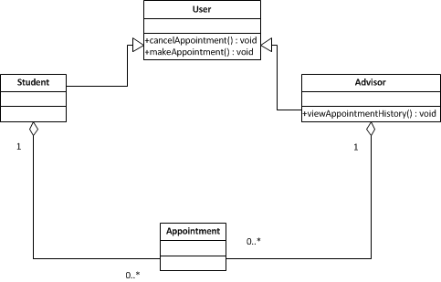
Class Diagram

Slide 3
Version Control Policy

Slide 4
Functional Requirements

Slide 5
Initial Tasks
Keenan – POJOS from the functional requirements -Student/Advisors
Jacqueline - Connect to LDAP
Mariam – Start created login screen, focus on creating new accounts for non-WSU students.

